Slide 1
Travel-reivews rating
The analysis ratings and reviews provide tremendous value to merchants to provide services and advertisments correctly. it provides businesses with valuable market and help them better understand the opinions and needs of the tourists.

Slide 2
dataset
Tarvel Review Ratings dataset ,I obtained it from Kaggle website. This data set is populated by capturing user ratings from Google reviews. Reviews on attractions from 24 categories across Europe are considered. Google user rating ranges from 1 to 5 and average user rating per category is calculated
My dataset contains more then 5000 instances and 25 features
In this project I will use all features in the dataset based on clustering algorithm to figure out how is the people visit certain places

Slide 3
Target Result
This dataset describes how users rate their estimates
my job is to learn how to grouped them in clusters. This is most secnificant important because it will allow us to work more efficiently with our users
based on clusters, we can offer people services more specifically.

Slide 4
Exploratory Data Analysis
In this phase we do that
1-Remove Nun values
2-Renamed columns
3-Remove missing values
4-Convert object values in to float values
5-Showed the feature scaling and relation between feature and save data after EDA

Slide 5
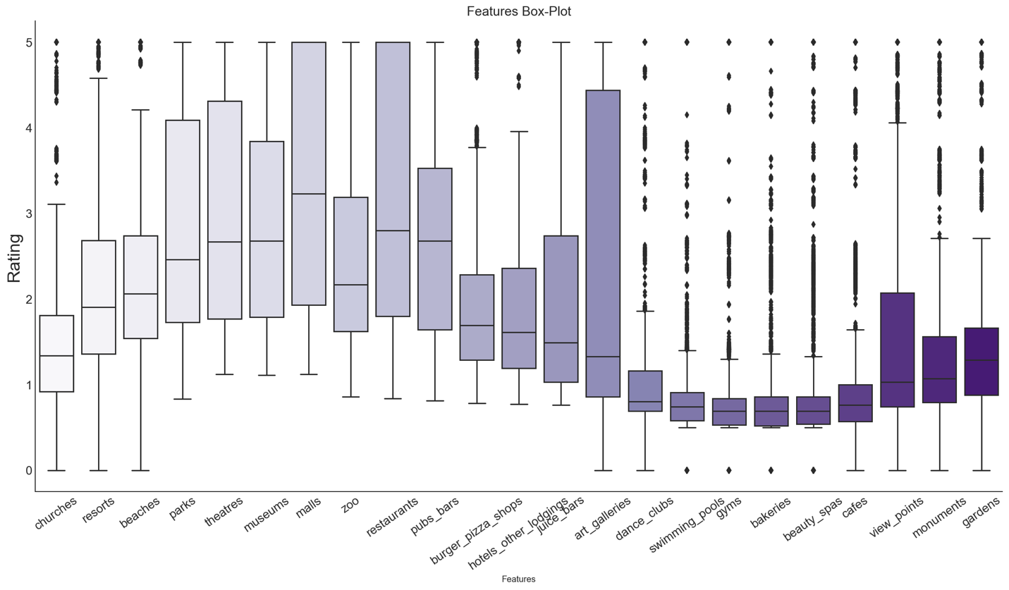
Checking outliur datapoint

Slide 6
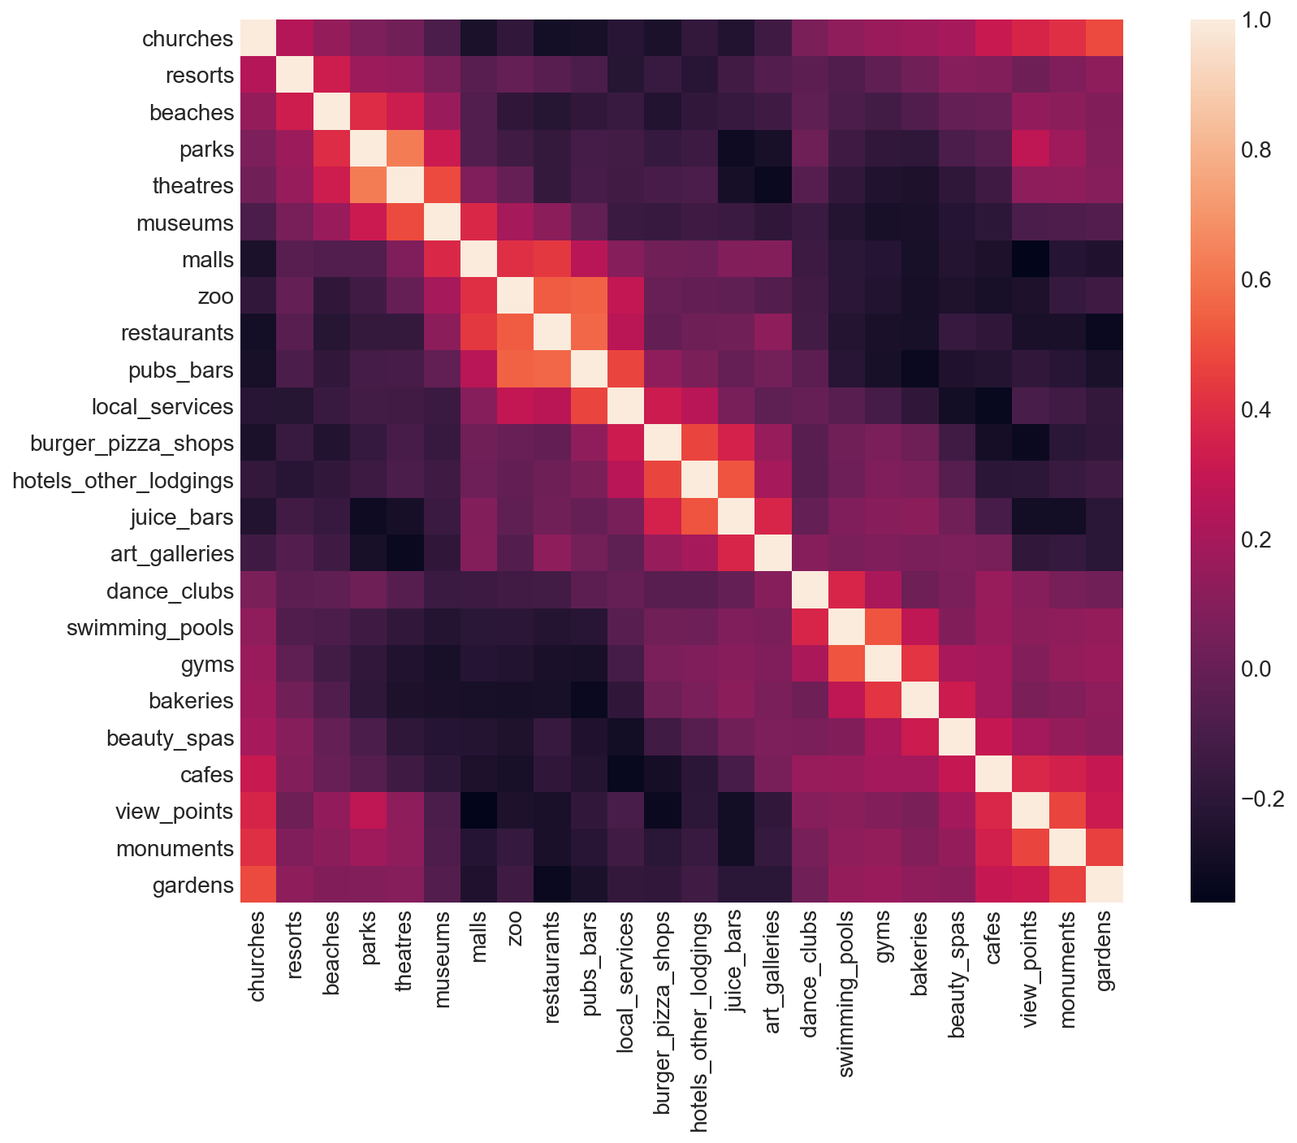
how our features are distributed

Slide 7
Preprocessing phase
We normalize catagroies in our data

Slide 8
clustering data by K-MEAN algorithm
Before we visualizing our data we cant get a clear plot of data according to a large number of features in our data
PCA is an algorithm that is used for dimensionality reduction - meaning, informally, that it can take in a DataFrame with many columns and return a DataFrame with a reduced number of columns that still retains much of the information from the columns of the original DataFrame.

Slide 9
We initialize our PCA models
displays our data point on the three principal components created for 3-D visualization

Slide 10
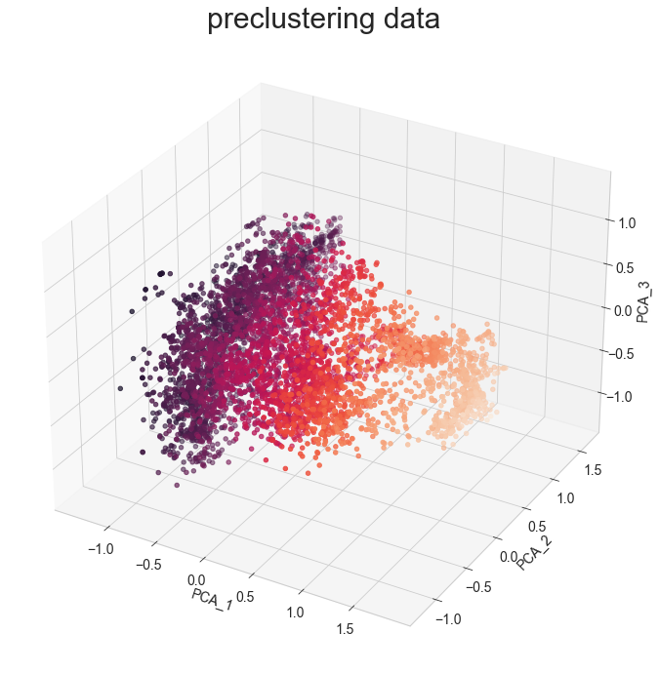

Slide 11
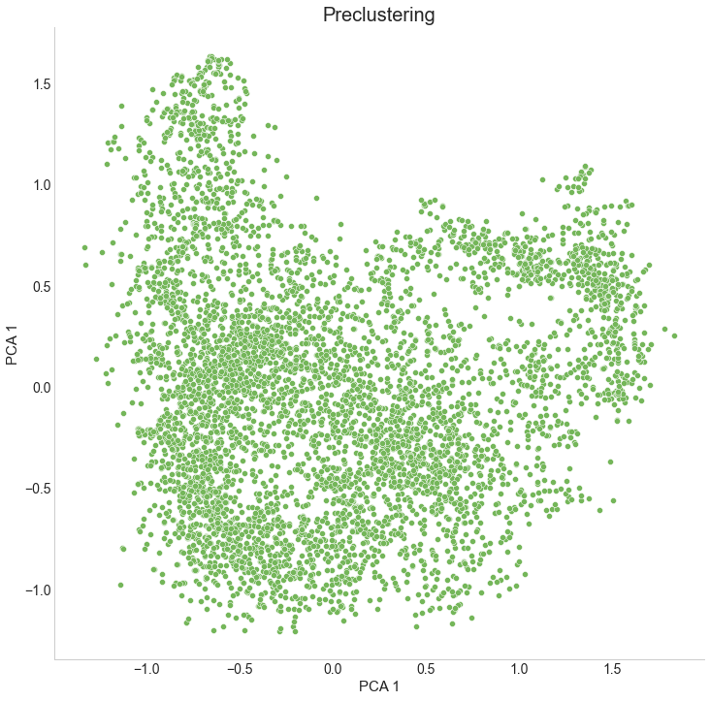
PCA Visualizations with 2D

Slide 12
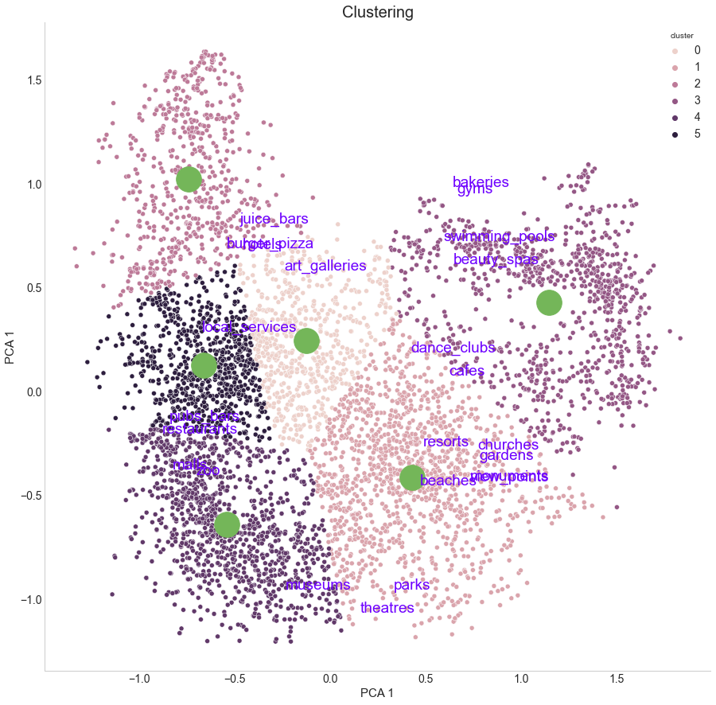
Applying K-mean clustering
According to result we can conclude that we have 6 groups of people who give estimates based on their rating

